Slide 1



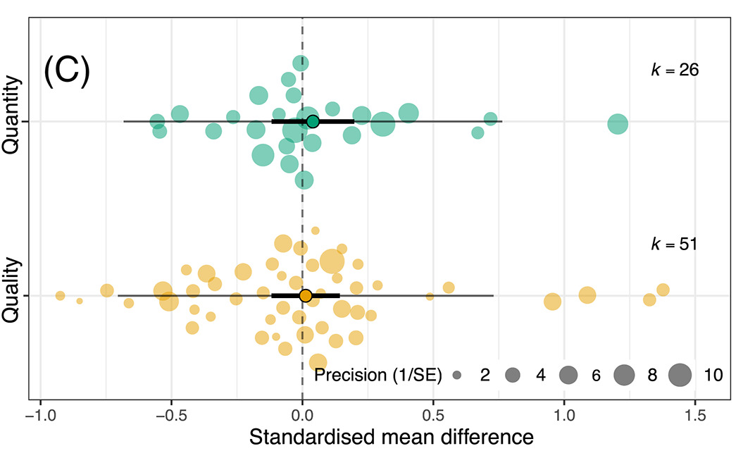
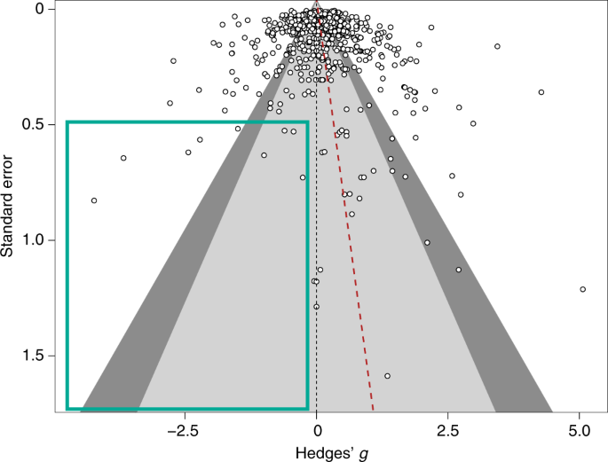




#SEBmeta
Meta-analysis in Comparative Physiology PART 2: Introduction to meta-analytic modelling: common challenges and advanced concepts
Nakagawa et al. 2021
De Boer et al. 2021
Daniel Noble, Nicholas Wu, Essie Rodgers, Patrice Pottier

Slide 2
Workshop Overview
Part 1: 9:00 – 10:30
What is meta-analysis and why should we use it?
Effect size and sampling variance: the key data for meta-analysis
What are effect sizes?
What types are out there and when to use?
Standardizing effect estimates – nuisance heterogeneity
Interpreting effect sizes and transformations
Assumptions, limitations, and common challenges
Part 2: 11:00 – 12:30
Meta-analytic modelling
Fixed and random effect meta-analyses
Multi-level meta-analytic models (MLMA): The main types in comparative physiology
Non-independence – phylogeny, study, species, shared controls
Robust variance estimation
Sensitivity analyses
Meta-regression and heterogeneity
Interpreting and reporting meta-analytic model output
Publication bias
Time-lag, reporting bias
Detecting and correcting
Part 3: 14:45 – 16:00
Help (advice) with your own meta-analysis! (if you need it)

Slide 3
Three main aims of meta-analysis
Finding generality across studies on the same (similar) topics
Meta-analysis
Sub-group meta-analysis
Finding consistency (inconsistency) among studies
Heterogeneity analysis
Explaining variation in effects
Meta-regression
Publication-bias tests

Slide 4
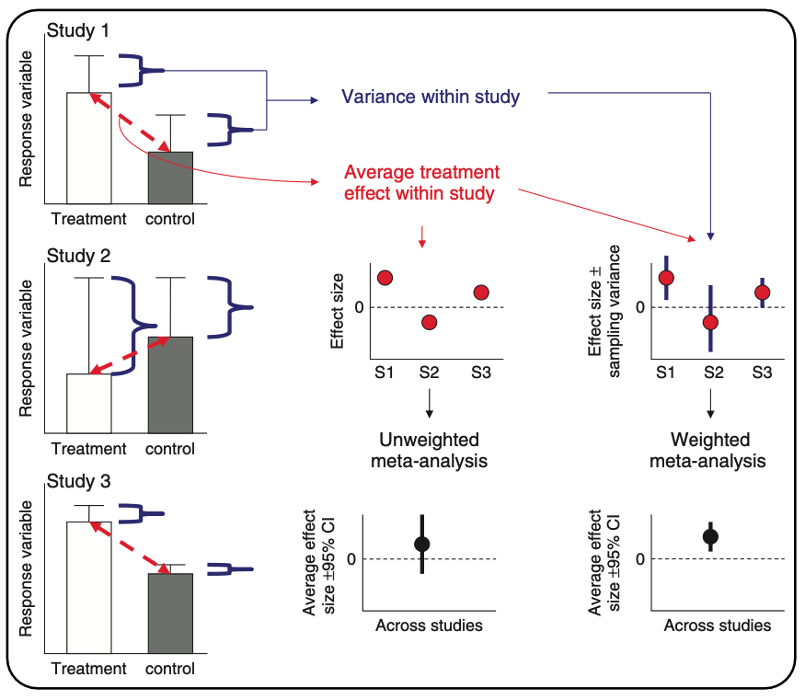
What meta-analysis is doing…
1. Meta-Analysis
Hillebrand & Gurevitch (2016). eLS

Slide 5
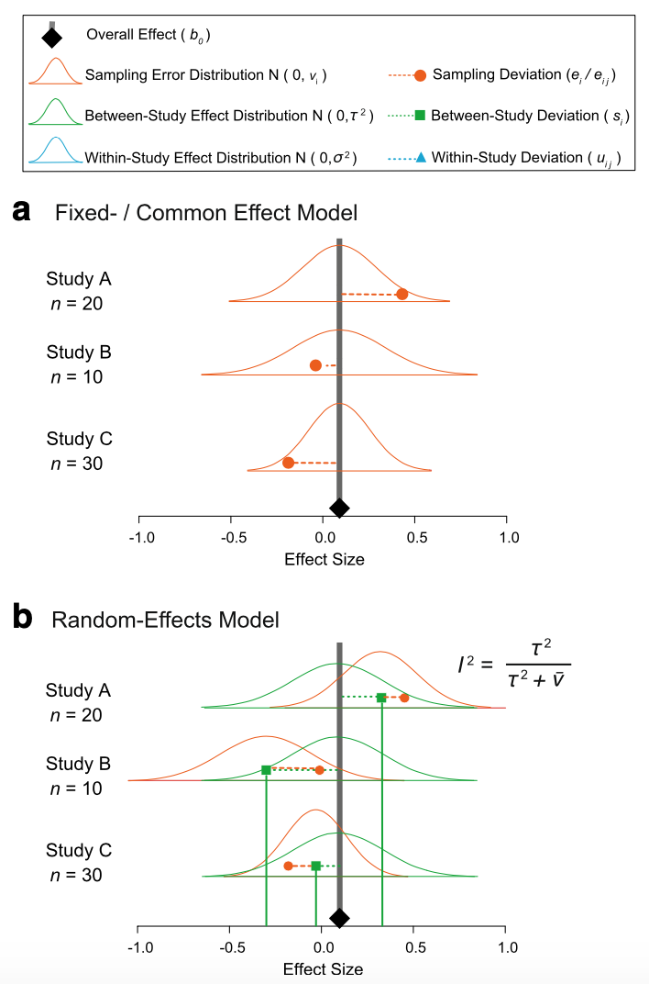

Fixed and random model assumptions
1. Meta-Analysis
Fixed (common) effect
All studies are estimating the same (common) “true” underlying effect
Variability between studies is due to random variation (chance) only

Slide 6
Fixed and random model assumptions
1. Meta-Analysis
Random effects
Each study has different “true” underlying effects
Variability between studies is due to random variation (chance) and actual differences

Slide 7
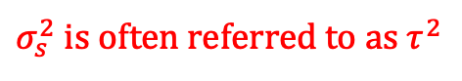
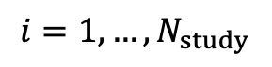
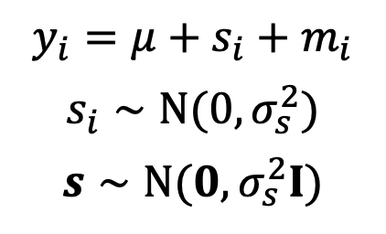
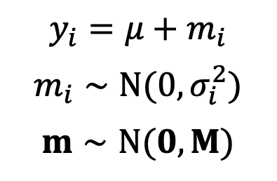
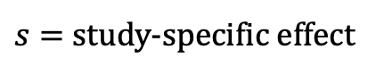
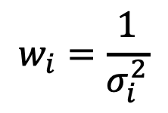
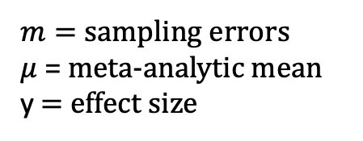
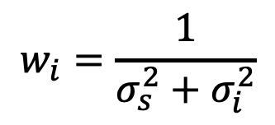
Fixed (common) and random: it’s just another linear model
1. Meta-Analysis
Fixed-effect meta-analysis
(common-effect meta-analysis)
Random-effects meta-analysis
$$y_{i}=μ+m_{i}$$
$$m_{i}∼N(0,σ_{i}^{2})$$
$$m∼N(0,M)$$
$$y_{i}=μ+s_{i}+m_{i}$$
$$s_{i}∼N(0,σ_{s}^{2})$$
$$s∼N(0,σ_{s}^{2}I)$$
$$w_{i}=\frac{1}{σ_{i}^{2}}$$
$$w_{i}=\frac{1}{σ_{s}^{2}+σ_{i}^{2}}$$
$$i=1,…,N_{study}$$
$s=$ study-specific effect
$m=$ sampling errors
$μ$ = meta-analytic mean
y $=$ effect size
$σ_{s}^{2}$ is often referred to as $τ^{2}$
Nakagawa & Santos (2012, Evol Ecol)
Notes:
Need to add more

Slide 8
Fixed (common) effect in code…
1. Meta-Analysis
# Generate some simulated effect size data with known sampling variance # assumed to come from a common underlying distribution set.seed(86) # Set see so that we all get the same simulated results
# We will have 5 studies stdy <- 1:5
# We know the variance for each effect Ves <- c(0.05, 0.10, 0.02, 0.10, 0.09)
# We'll need this later but these are weights W <- 1 / Ves
# We assume they are sampled from a normal distribution with a mean effect size of 2 es <- rnorm(length(Ves), 2, sqrt(Ves))
# Data for our fixed effect meta-analysis dataFE <- data.frame(stdy = stdy, es, Ves)

Slide 9
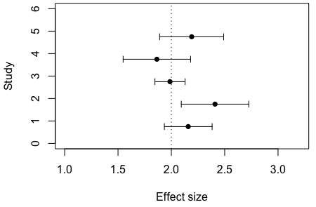
Fixed effects model data…
1. Meta-Analysis

Slide 10
Fixed effect model meta-analysis..
1. Meta-Analysis
# Run a fixed effect meta-analysis using the FE dataset. metafor::rma(yi = es, vi = Ves, method = "FE", data = dataFE)
## ## Fixed-Effects Model (k = 5) ## ## I^2 (total heterogeneity / total variability): 0.00% ## H^2 (total variability / sampling variability): 0.56 ## ## Test for Heterogeneity: ## Q(df = 4) = 2.2340, p-val = 0.6928 ## ## Model Results: ## ## estimate se zval pval ci.lb ci.ub ​ ## 2.0731 0.0994 20.8459 <.0001 1.8782 2.2680 *** ## ## --- ## Signif. codes: 0 '***' 0.001 '**' 0.01 '*' 0.05 '.' 0.1 ' ' 1

Slide 11
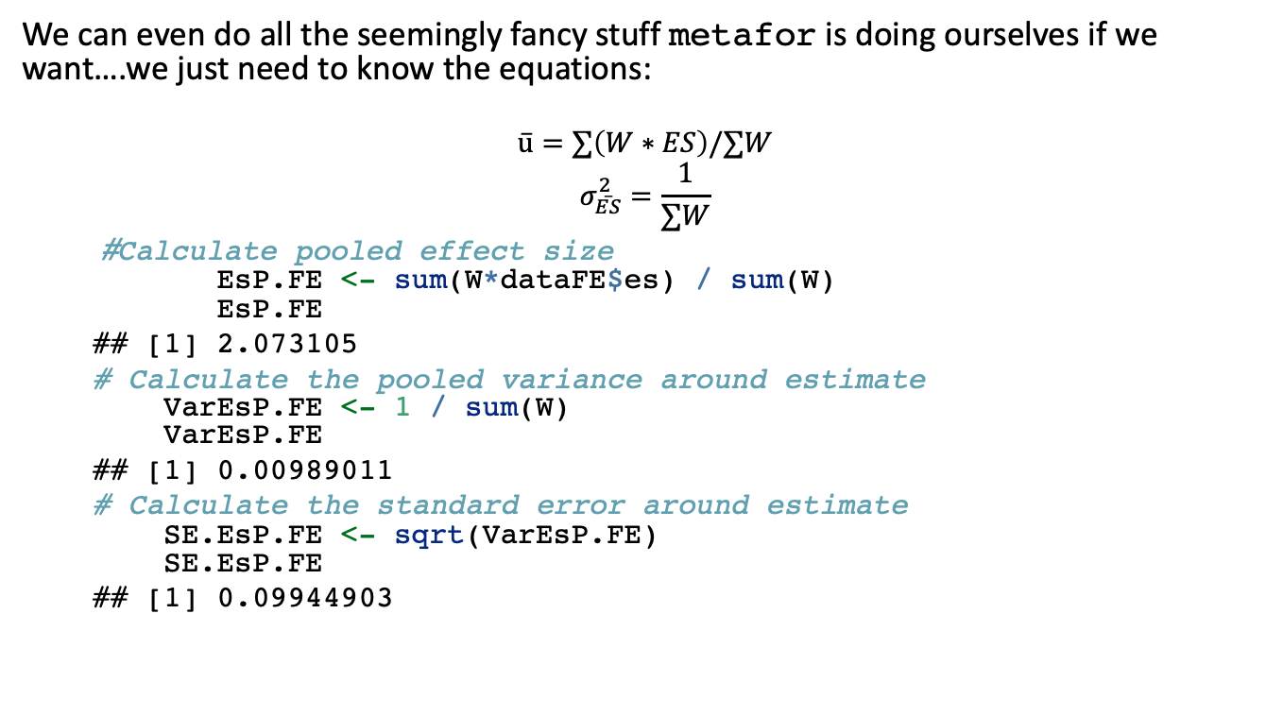
Now a fixed effect analysis by hand…
1. Meta-Analysis
We can even do all the seemingly fancy stuff metafor is doing ourselves if we want….we just need to know the equations:
$$\overset{‾}{u}=∑\left(W∗ES\right)/∑W$$
$$σ_{\overset{‾}{ES}}^{2}=\frac{1}{∑W}$$
# Calculate pooled effect size EsP.FE <- sum(W*dataFE$es) / sum(W) EsP.FE
## [1] 2.073105
# Calculate the pooled variance around estimate VarEsP.FE <- 1 / sum(W) VarEsP.FE
## [1] 0.00989011
# Calculate the standard error around estimate SE.EsP.FE <- sqrt(VarEsP.FE) SE.EsP.FE
## [1] 0.09944903
# We'll need this later but these are weights W <- 1 / Ves
## estimate se zval pval ci.lb ci.ub ​ ## 2.0731 0.0994 20.8459 <.0001 1.8782 2.2680 ***

Slide 12

Now a fixed effect analysis by hand…
1. Meta-Analysis
We can even do all the seemingly fancy stuff metafor is doing ourselves if we want….we just need to know the equations:
$$\overset{‾}{u}=∑\left(W∗yi\right)/∑W$$
$$σ_{\overset{‾}{ES}}^{2}=\frac{1}{∑W}$$
# Calculate pooled effect size EsP.FE <- sum(W*dataFE$es) / sum(W) EsP.FE
## [1] 2.073105
# Calculate the pooled variance around estimate VarEsP.FE <- 1 / sum(W) VarEsP.FE
## [1] 0.00989011
# Calculate the standard error around estimate SE.EsP.FE <- sqrt(VarEsP.FE) SE.EsP.FE
## [1] 0.09944903
# We'll need this later but these are weights W <- 1 / Ves
## estimate se zval pval ci.lb ci.ub ​ ## 2.0731 0.0994 20.8459 <.0001 1.8782 2.2680 ***

Slide 13
Now a fixed effect analysis by hand…
1. Meta-Analysis
We can even do all the seemingly fancy stuff metafor is doing ourselves if we want….we just need to know the equations:
$$\overset{‾}{u}=∑\left(W∗yi\right)/∑W$$
$$σ_{\overset{‾}{ES}}^{2}=\frac{1}{∑W}$$
# Calculate pooled effect size EsP.FE <- sum(W*dataFE$es) / sum(W) EsP.FE
## [1] 2.073105
# Calculate the pooled variance around estimate VarEsP.FE <- 1 / sum(W) VarEsP.FE
## [1] 0.00989011
# Calculate the standard error around estimate SE.EsP.FE <- sqrt(VarEsP.FE) SE.EsP.FE
## [1] 0.09944903
## estimate se zval pval ci.lb ci.ub ​ ## 2.0731 0.0994 20.8459 <.0001 1.8782 2.2680 ***

Slide 14

Now a fixed effect analysis by hand…
1. Meta-Analysis
We can even do all the seemingly fancy stuff metafor is doing ourselves if we want….we just need to know the equations:
$$\overset{‾}{u}=∑\left(W∗yi\right)/∑W$$
$$σ_{\overset{‾}{ES}}^{2}=\frac{1}{∑W}$$
# Calculate pooled effect size EsP.FE <- sum(W*dataFE$es) / sum(W) EsP.FE
## [1] 2.073105
# Calculate the pooled variance around estimate VarEsP.FE <- 1 / sum(W) VarEsP.FE
## [1] 0.00989011
# Calculate the standard error around estimate SE.EsP.FE <- sqrt(VarEsP.FE) SE.EsP.FE
## [1] 0.09944903
## estimate se zval pval ci.lb ci.ub ​ ## 2.0731 0.0994 20.8459 <.0001 1.8782 2.2680 ***
Notes:
2.073105 / 0.09944903 gets you the zval
2*pnorm(20.8459, lower.tail = FALSE) gets you the p-value for this

Slide 15
Random effect model in code….
1. Meta-Analysis
# Effect size is sampled from a larger distribution of effect sizes that itself comes from a distribution with a variance of 0.8.
esRE <- rnorm(length(Ves), 2, sqrt(Ves + 0.8))
# Data for our random effect meta-analysis dataRE <- data.frame(stdy = stdy, esRE, Ves)

Slide 16
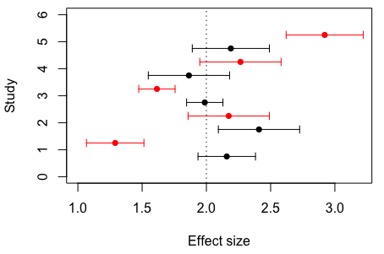
Random effect model data…
1. Meta-Analysis
Mean (arrows are sampling standard deviation) effect size for each study. Data simulated under a fixed effect model in black and data simulated under a random effect model in red.

Slide 17
Random effects model meta-analysis..
1. Meta-Analysis
# Random effect meta-analysis
metafor::rma(yi = esRE, vi = Ves, method="DL", data = dataRE)
## ## Random-Effects Model (k = 5; tau^2 estimator: DL) ## ## tau^2 (estimated amount of total heterogeneity): 0.2947 (SE = 0.2731) ## tau (square root of estimated tau^2 value): 0.5429 ## I^2 (total heterogeneity / total variability): 83.61% ## H^2 (total variability / sampling variability): 6.10 ## ## Test for Heterogeneity: ## Q(df = 4) = 24.4015, p-val < .0001 ## ## Model Results: ## ## estimate se zval pval ci.lb ci.ub ​ ## 2.0163 0.2697 7.4753 <.0001 1.4876 2.5449 *** ## ## --- ## Signif. codes: 0 '***' 0.001 '**' 0.01 '*' 0.05 '.' 0.1 ' ' 1

Slide 18
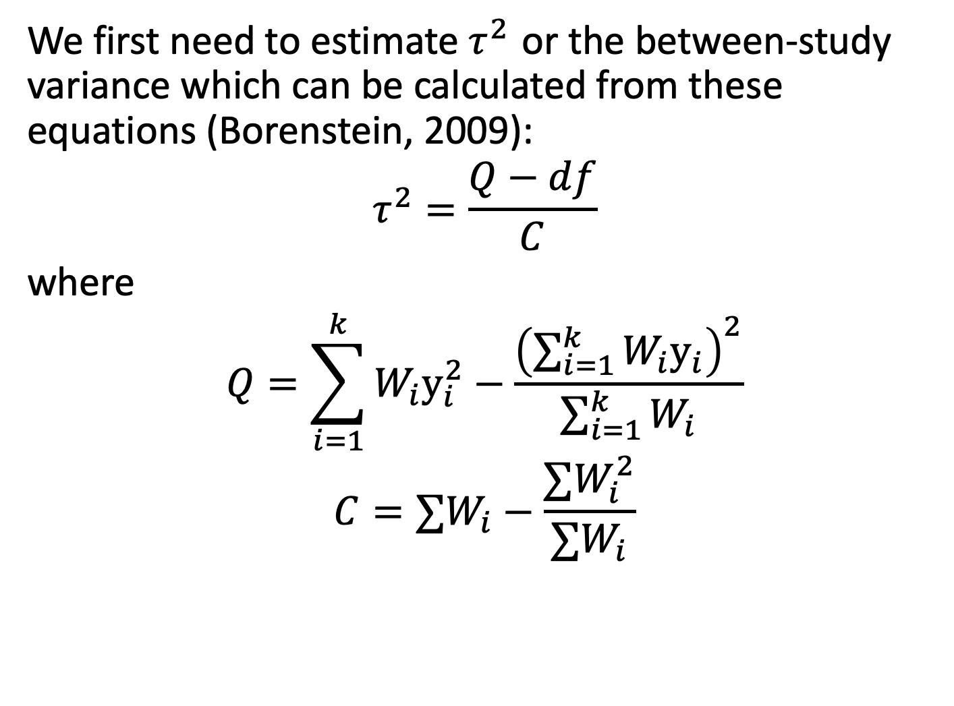
Now a random effect analysis by hand…
1. Meta-Analysis
We first need to estimate $τ^{2}$ or the between-study variance which can be calculated from these equations (Borenstein, 2009):
$$τ^{2}=\frac{Q−df}{C}$$
where
$$Q=\sum_{i=1}^{k}{W_{i}y_{i}^{2}}−\frac{{\left(\sum_{i=1}^{k}{W_{i}y_{i}}\right)}^{2}}{\sum_{i=1}^{k}{W_{i}}}$$
$$C=∑W_{i}−\frac{∑W_{i}^{2}}{∑W_{i}}$$

Slide 19
1. Meta-Analysis
Now a random effect analysis by hand…
# Calculate our Q statistic again Q <- sum(W*(dataRE$es^2) ) - (sum(W*dataRE$es)^2 / sum(W)) Q
## [1] 24.40149
# Calculate C C <- sum(W) - ((sum(W^2))/sum(W)) C
## [1] 69.23077
# Calculate df & tau2 df <- nrow(dataRE) - 1 T2 <- (Q - df) / C T2
## [1] 0.2946883
## Test for Heterogeneity: ## Q(df = 4) = 24.4015, p-val < .0001
## tau^2 (estimated amount of total heterogeneity): 0.2947 (SE = 0.2731)
Notes:
How to get p-value from Q test, which is a chi-square
2*pchisq(24.40149, 4, lower.tail = FALSE)
[1] 0.0001327126

Slide 20
1. Meta-Analysis
Now a random effect analysis by hand…
Remember, things are the same but the weighting is different now.
# RE weights W.re <- 1 / (T2 + dataRE$Ves) #Pooled effect size for random effect meta-analysis esPoolRE <- sum(W.re*dataRE$es) / sum(W.re) esPoolRE
## [1] 2.016261
# Calculate the pooled variance around estimate VarES <- 1 / sum(W.re) # Calculate the standard error around estimate SE.ES.RE <- sqrt(VarES) SE.ES.RE
## [1] 0.2697219
## estimate se zval pval ci.lb ci.ub ​ ## 2.0163 0.2697 7.4753 <.0001 1.4876 2.5449 ***

Slide 21

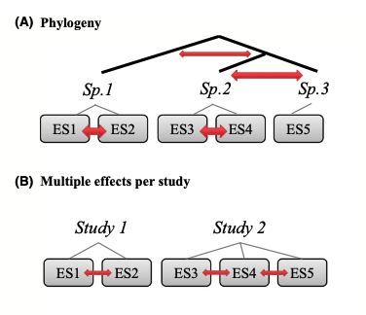
More complex non-independence
1. Meta-Analysis

Slide 22
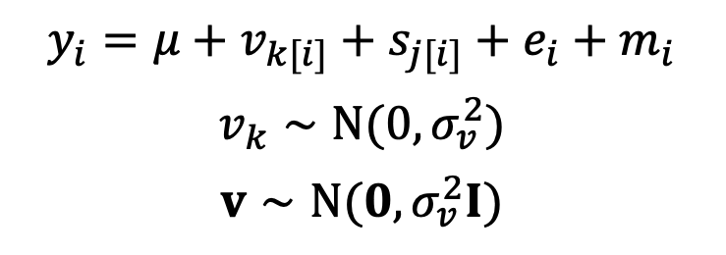
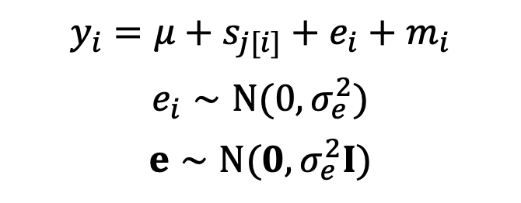
More complex meta-analysis: Multi-level meta-analysis
1. Meta-Analysis
Multilevel meta-analysis 1
$$y_{i}=μ+s_{j[i]}+e_{i}+m_{i}$$
$$e_{i}∼N(0,σ_{e}^{2})$$
$$e∼N(0,σ_{e}^{2}I)$$
i = ith effect size
j = jth study
e = effect-size specific effect
Or = within-study effect
Or = residual
Multilevel meta-analysis 2
$$y_{i}=μ+v_{k[i]}+s_{j[i]}+e_{i}+m_{i}$$
$$v_{k}∼N(0,σ_{v}^{2})$$
$$v∼N(0,σ_{v}^{2}I)$$
v = species-specific effect
If species (kth species)
v = location-specific effect
If locations (kth location)

Slide 23
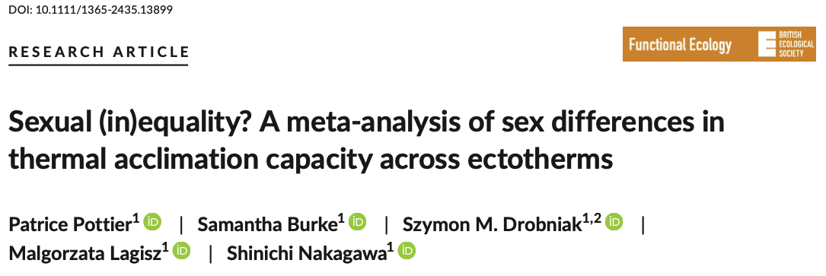
Example
1. Meta-Analysis
# install.packages("pacman") ; uncomment this line if you haven't already installed 'pacman'
pacman::p_load(metafor, tidyverse) asr_dat <- read.csv("https://osf.io/qn2af/download")
#' @title arr #' @description Calculates the acclimation response ratio (ARR). #' @param t2_l Lowest of the two treatment temperatures #' @param t1_h Highest of the two treatment temperatures #' @param x1_h Mean trait value at high temperature #' @param x2_l Mean trait value at low temperature #' @param sd1_h Standard deviation of mean trait value at high temperature #' @param sd2_l Standard deviation of mean trait value at low temperature #' @param n1_h Sample size at high temperature #' @param n2_l Sample size at low temperature arr <- function(x1_h, x2_l, sd1_h, sd2_l, n1_h, n2_l, t1_h, t2_l){ ARR <- (x1_h - x2_l)/(t1_h - t2_l) V_ARR <- ((1/(t1_h - t2_l))^2*(sd2_l^2/n2_l + sd1_h^2/n1_h)) return(data.frame(ARR, V_ARR)) }

Slide 24
Caluclate ARR
1. Meta-Analysis
# Calculate the effect sizes asr_dat <- asr_dat %>% mutate(ARR = arr(x1_h = mean_high, x2_l = mean_low,
t1_h = acc_temp_high, t2_l = acc_temp_low, sd1_h = sd_high, sd2_l = sd_low,
n1_h = n_high_adj, n2_l = n_low_adj)[, 1], V_ARR = arr(x1_h = mean_high, x2_l = mean_low,
t1_h = acc_temp_high, t2_l = acc_temp_low, sd1_h = sd_high, sd2_l = sd_low,
n1_h = n_high_adj, n2_l = n_low_adj)[,2]) %>% filter(sex == "female")

Slide 25
Multilevel Meta-analytic Model
1. Meta-Analysis
# Multi-level meta-analytic model MLMA <- metafor::rma.mv(yi= ARR~ 1, V = V_ARR, method="REML", random=list(~1|species_ID, ~1|authors, ~1|es_ID), dfs = "contain", test="t", data=asr_dat) ## Multivariate Meta-Analysis Model (k = 123; method: REML) ## ## Variance Components: ## ## estim sqrt nlvls fixed factor ## sigma^2.1 0.0008 0.0280 29 no species_ID ## sigma^2.2 0.0154 0.1241 21 no authors ## sigma^2.3 0.0097 0.0987 123 no es_ID ## ## Test for Heterogeneity: ## Q(df = 122) = 3941.0055, p-val < .0001 ## ## Model Results: ## ## estimate se tval df pval ci.lb ci.ub ​ ## 0.1668 0.0316 5.2857 20 <.0001 0.1010 0.2327 *** ## ## --- ## Signif. codes: 0 '***' 0.001 '**' 0.01 '*' 0.05 '.' 0.1 ' ' 1

Slide 26
Multilevel Meta-analytic Model
1. Meta-Analysis
# Multi-level meta-analytic model MLMA <- metafor::rma.mv(yi= ARR~ 1, V = V_ARR, method="REML", random=list(~1|species_ID, ~1|authors, ~1|es_ID), dfs = "contain", test="t", data=asr_dat) ## Multivariate Meta-Analysis Model (k = 123; method: REML) ## ## Variance Components: ## ## estim sqrt nlvls fixed factor ## sigma^2.1 0.0008 0.0280 29 no species_ID ## sigma^2.2 0.0154 0.1241 21 no authors ## sigma^2.3 0.0097 0.0987 123 no es_ID ## ## Test for Heterogeneity: ## Q(df = 122) = 3941.0055, p-val < .0001 ## ## Model Results: ## ## estimate se tval df pval ci.lb ci.ub ​ ## 0.1668 0.0316 5.2857 20 <.0001 0.1010 0.2327 *** ## ## --- ## Signif. codes: 0 '***' 0.001 '**' 0.01 '*' 0.05 '.' 0.1 ' ' 1
Overall meta-analytic mean as 0.167
95% confidence interval of 0.101 to 0.233

Slide 27
Phylogenetic meta-analysis
1. Meta-Analysis

Slide 28
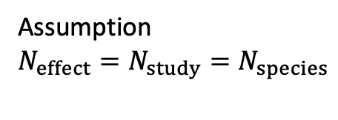
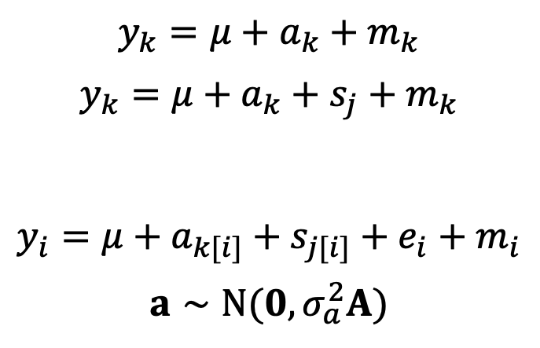

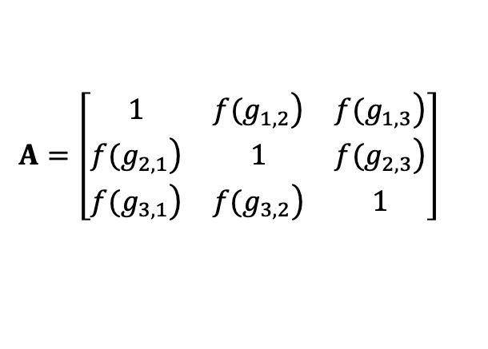
Phylogenetic meta-analysis
1. Meta-Analysis
Phylogenetic common-effect & random-effects models
$$y_{k}=μ+a_{k}+m_{k}$$
$$y_{k}=μ+a_{k}+s_{j}+m_{k}$$
$$y_{i}=μ+a_{k[i]}+s_{j[i]}+e_{i}+m_{i}$$
$$a∼N(0,σ_{a}^{2}A)$$
Adams (2008)
a = phylogenetic effect
k^{th} species
Lajeunesse (2009)
Assumption
$$N_{effect}=N_{study}=N_{species}$$
Our notation assumes:
$$N_{effect}>N_{study}>N_{species}$$
Hadfield & Nakagawa (2010)
A = correlation matrix of species distances
$$A=\left[\begin{matrix}1 & \left.f(g_{1,2}\right) & \left.f(g_{1,3}\right) \\ \left.f(g_{2,1}\right) & 1 & \left.f(g_{2,3}\right) \\ \left.f(g_{3,1}\right) & \left.f(g_{3,2}\right) & 1\end{matrix}\right]$$
The case with 3 effect sizes (species)
f = function; g = distance between the root and the common ancestor

Slide 29
Phylogenetic meta-analysis
1. Meta-Analysis
Phylogenetic common-effect & random-effects models
$$y_{k}=μ+a_{k}+m_{k}$$
$$y_{k}=μ+a_{k}+s_{j}+m_{k}$$
$$y_{i}=μ+a_{k[i]}+s_{j[i]}+e_{i}+m_{i}$$
$$a∼N(0,σ_{a}^{2}A)$$
Adams (2008)
a = phylogenetic effect
k^{th} species
Lajeunesse (2009)
Assumption
$$N_{effect}=N_{study}=N_{species}$$
Our notation assumes:
$$N_{effect}>N_{study}>N_{species}$$
Hadfield & Nakagawa (2010)
A = correlation matrix of species distances
$$A=\left[\begin{matrix}1 & \left.f(g_{1,2}\right) & \left.f(g_{1,3}\right) \\ \left.f(g_{2,1}\right) & 1 & \left.f(g_{2,3}\right) \\ \left.f(g_{3,1}\right) & \left.f(g_{3,2}\right) & 1\end{matrix}\right]$$
The case with 3 effect sizes (species)
f = function; g = distance between the root and the common ancestor

Slide 30
Phylogenetic meta-analysis
1. Meta-Analysis
Phylogenetic common-effect & random-effects models
$$y_{k}=μ+a_{k}+m_{k}$$
$$y_{k}=μ+a_{k}+s_{j}+m_{k}$$
$$y_{i}=μ+a_{k[i]}+s_{j[i]}+e_{i}+m_{i}$$
$$a∼N(0,σ_{a}^{2}A)$$
Adams (2008)
a = phylogenetic effect
k^{th} species
Lajeunesse (2009)
Assumption
$$N_{effect}=N_{study}=N_{species}$$
Our notation assumes:
$$N_{effect}>N_{study}>N_{species}$$
Hadfield & Nakagawa (2010)
A = correlation matrix of species distances
$$A=\left[\begin{matrix}1 & \left.f(g_{1,2}\right) & \left.f(g_{1,3}\right) \\ \left.f(g_{2,1}\right) & 1 & \left.f(g_{2,3}\right) \\ \left.f(g_{3,1}\right) & \left.f(g_{3,2}\right) & 1\end{matrix}\right]$$
The case with 3 effect sizes (species)
f = function; g = distance between the root and the common ancestor

Slide 31

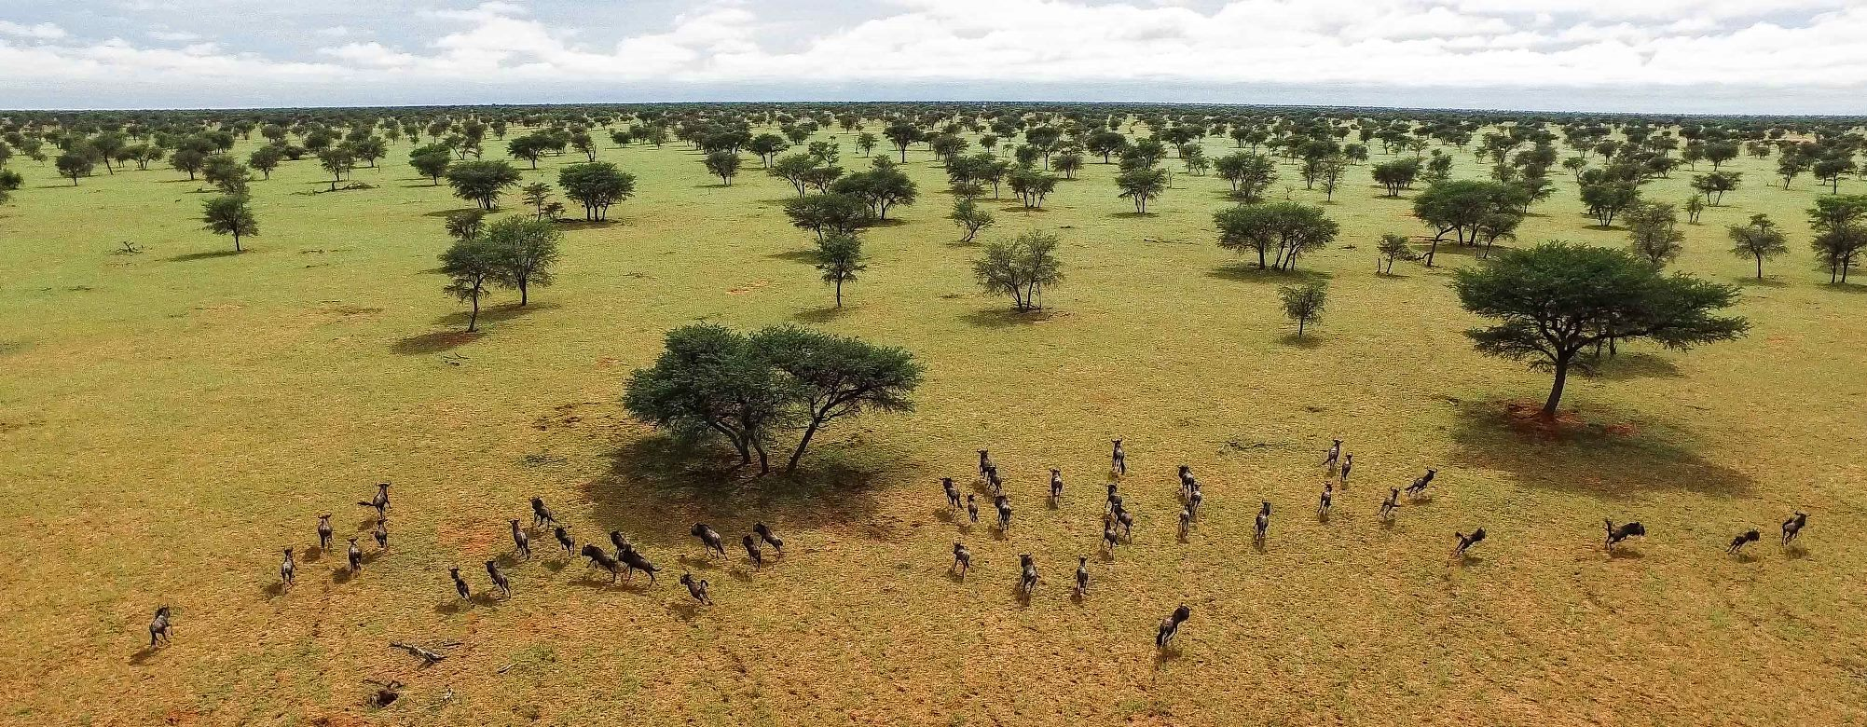
Let’s do a phylogenetic meta-analysis….
https://daniel1noble.github.io/meta-workshop/phylo

Slide 32
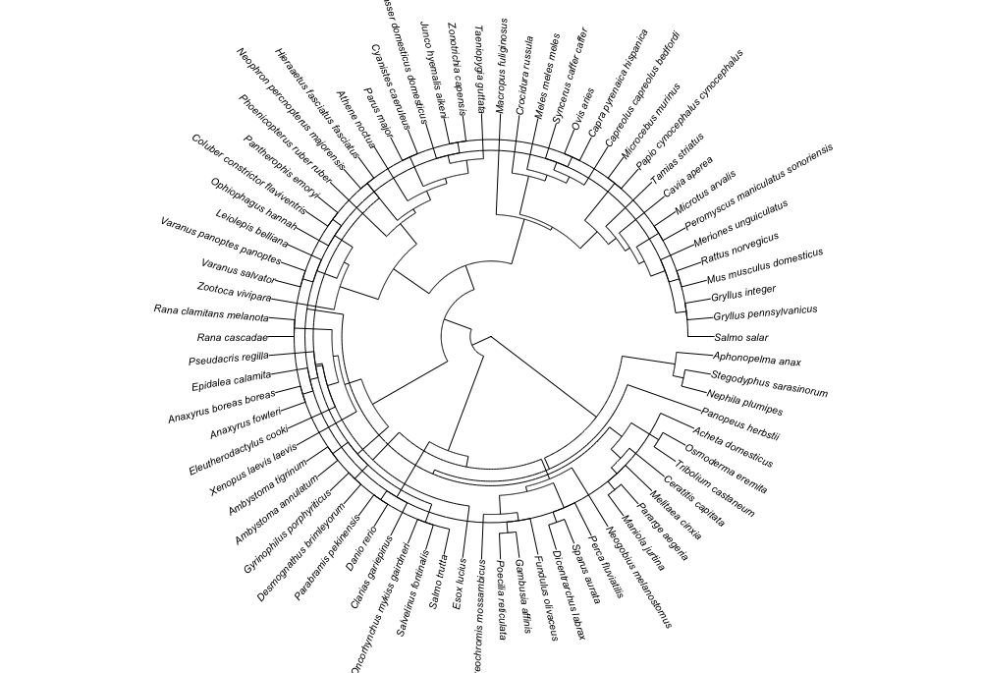
Phylogenetic tree

Slide 33
1. Meta-Analysis
Our phylogenetic model results…
overall_model <- metafor::rma.mv(yi = Zr, V = V_Zr, mod = ~1, random = list(~1 | study_ID, ~1 | es_ID, ~1 | species, ~1 | species_OTL), R = list(species_OTL = phylo_cor), method = "REML", test = "t", dfs = "contain", data = zr_data %>% dplyr::mutate(species_OTL = stringr::str_replace_all(species_OTL, " ", "_"))) summary(overall_model)
## ## Multivariate Meta-Analysis Model (k = 272; method: REML) ## ## logLik Deviance AIC BIC AICc ​ ## -160.5426 321.0852 331.0852 349.0958 331.3116 ## ## Variance Components: ## ## estim sqrt nlvls fixed factor R ## sigma^2.1 0.0016 0.0398 88 no study_ID no ## sigma^2.2 0.1155 0.3399 272 no es_ID no ## sigma^2.3 0.0260 0.1614 79 no species no ## sigma^2.4 0.0000 0.0000 74 no species_OTL yes ## ## Test for Heterogeneity: ## Q(df = 271) = 2508.8317, p-val < .0001 ## ## Model Results: ## ## estimate se tval df pval ci.lb ci.ub ​ ## 0.0979 0.0347 2.8202 73 0.0062 0.0287 0.1671 ** ## ## --- ## Signif. codes: 0 '***' 0.001 '**' 0.01 '*' 0.05 '.' 0.1 ' ' 1

Slide 34
1. Meta-Analysis
Our phylogenetic model results…
overall_model <- metafor::rma.mv(yi = Zr, V = V_Zr, mod = ~1, random = list(~1 | study_ID, ~1 | es_ID, ~1 | species, ~1 | species_OTL), R = list(species_OTL = phylo_cor), method = "REML", test = "t", dfs = "contain", data = zr_data %>% dplyr::mutate(species_OTL = stringr::str_replace_all(species_OTL, " ", "_"))) summary(overall_model)
## ## Multivariate Meta-Analysis Model (k = 272; method: REML) ## ## logLik Deviance AIC BIC AICc ​ ## -160.5426 321.0852 331.0852 349.0958 331.3116 ## ## Variance Components: ## ## estim sqrt nlvls fixed factor R ## sigma^2.1 0.0016 0.0398 88 no study_ID no ## sigma^2.2 0.1155 0.3399 272 no es_ID no ## sigma^2.3 0.0260 0.1614 79 no species no ## sigma^2.4 0.0000 0.0000 74 no species_OTL yes ## ## Test for Heterogeneity: ## Q(df = 271) = 2508.8317, p-val < .0001 ## ## Model Results: ## ## estimate se tval df pval ci.lb ci.ub ​ ## 0.0979 0.0347 2.8202 73 0.0062 0.0287 0.1671 ** ## ## --- ## Signif. codes: 0 '***' 0.001 '**' 0.01 '*' 0.05 '.' 0.1 ' ' 1
What does this model tell us about how important evolutionary history among species is in explaining variation in the relationship between physiology and dispersal?

Slide 35
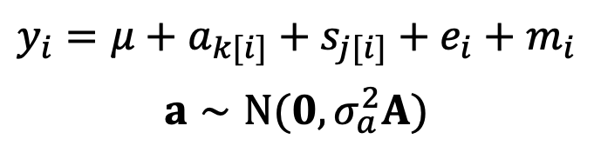
1. Meta-Analysis
Our phylogenetic model results…
overall_model <- metafor::rma.mv(yi = Zr, V = V_Zr, mod = ~1, random = list(~1 | study_ID, ~1 | es_ID, ~1 | species, ~1 | species_OTL), R = list(species_OTL = phylo_cor), method = "REML", test = "t", dfs = "contain", data = zr_data %>% dplyr::mutate(species_OTL = stringr::str_replace_all(species_OTL, " ", "_"))) summary(overall_model)
## ## Multivariate Meta-Analysis Model (k = 272; method: REML) ## ## logLik Deviance AIC BIC AICc ​ ## -160.5426 321.0852 331.0852 349.0958 331.3116 ## ## Variance Components: ## ## estim sqrt nlvls fixed factor R ## sigma^2.1 0.0016 0.0398 88 no study_ID no ## sigma^2.2 0.1155 0.3399 272 no es_ID no ## sigma^2.3 0.0260 0.1614 79 no species no ## sigma^2.4 0.0000 0.0000 74 no species_OTL yes ## ## Test for Heterogeneity: ## Q(df = 271) = 2508.8317, p-val < .0001 ## ## Model Results: ## ## estimate se tval df pval ci.lb ci.ub ​ ## 0.0979 0.0347 2.8202 73 0.0062 0.0287 0.1671 ** ## ## --- ## Signif. codes: 0 '***' 0.001 '**' 0.01 '*' 0.05 '.' 0.1 ' ' 1
$$y_{i}=μ+a_{k[i]}+s_{j[i]}+e_{i}+m_{i}$$
$$a∼N(0,σ_{a}^{2}A)$$
How does this model differ from the phylogenetic meta-analytic model we described in previous slides?

Slide 36
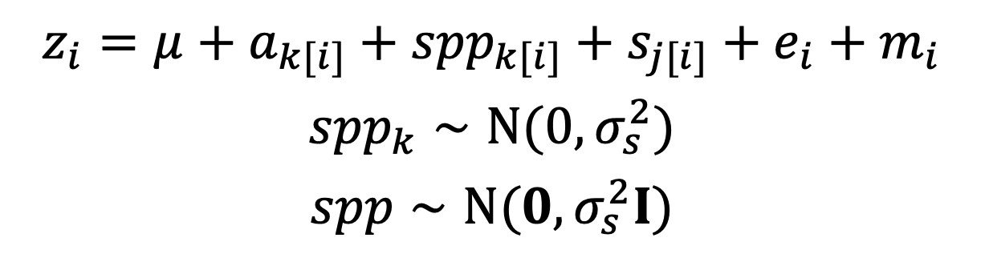
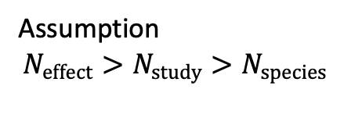
1. Meta-Analysis
$$z_{i}=μ+a_{k[i]}+{spp}_{k[i]}+s_{j[i]}+e_{i}+m_{i}$$
$${spp}_{k}∼N(0,σ_{s}^{2})$$
$$spp∼N(0,σ_{s}^{2}I)$$
s = non-phylogenetic part of species effect
Assumption
$$N_{effect}>N_{study}>N_{species}$$
Stop and think; it is all good in theory…..
Can we distinguish a and spp?

Slide 37

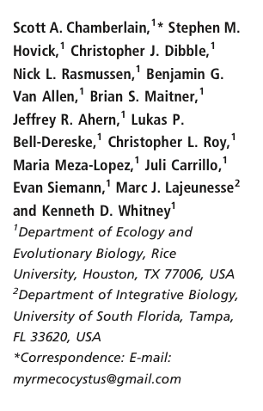

1. Meta-Analysis
$$z_{i}=μ+a_{k[i]}+{spp}_{k[i]}+s_{j[i]}+e_{i}+m_{i}$$
$${spp}_{k}∼N(0,σ_{s}^{2})$$
$$spp∼N(0,σ_{s}^{2}I)$$
s = non-phylogenetic part of species effect
Assumption
$$N_{effect}>N_{study}>N_{species}$$
Stop and think: it is all good in theory…..
Can we distinguish s and u?

Slide 38
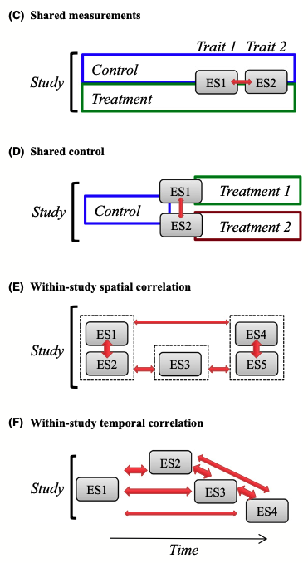
More complex non-independence
1. Meta-Analysis
But see also:
- Gleser & Olkin (2009)
- Lajeunesse (2011)
- Koricheva et al. (2013)

Slide 39
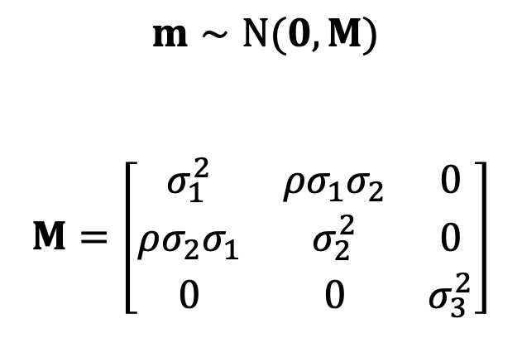
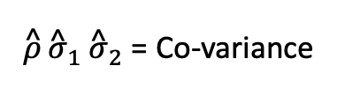
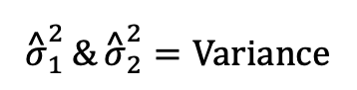
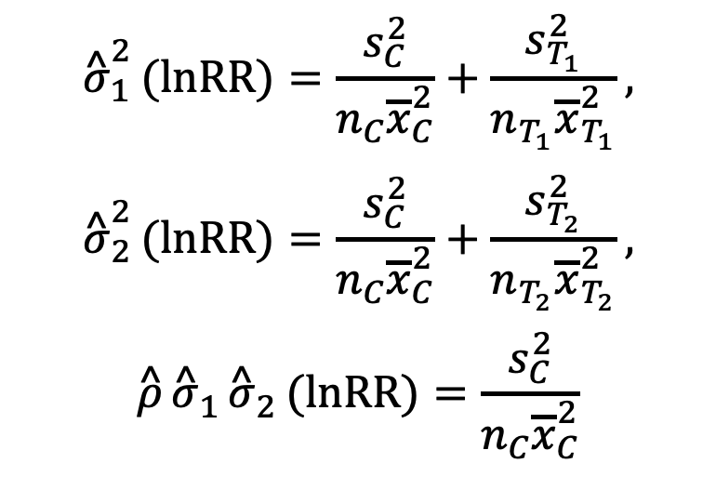
Shared-Control Non-independence
1. Meta-Analysis
$m∼N(0,M)$
$$M=\left[\begin{matrix}σ_{1}^{2} & ρσ_{1}σ_{2} & 0 \\ ρσ_{2}σ_{1} & σ_{2}^{2} & 0 \\ 0 & 0 & σ_{3}^{2}\end{matrix}\right]$$
$${\overset{^}{σ}}_{1}^{2}(lnRR)=\frac{s_{C}^{2}}{n_{C}{\overline{x}}_{C}^{2}}+\frac{s_{T_{1}}^{2}}{n_{T_{1}}{\overline{x}}_{T_{1}}^{2}},$$
$${\overset{^}{σ}}_{2}^{2}(lnRR)=\frac{s_{C}^{2}}{n_{C}{\overline{x}}_{C}^{2}}+\frac{s_{T_{2}}^{2}}{n_{T_{2}}{\overline{x}}_{T_{2}}^{2}},$$
$$\overset{^}{ρ}{\overset{^}{σ}}_{1}{\overset{^}{σ}}_{2}(lnRR)=\frac{s_{C}^{2}}{n_{C}{\overline{x}}_{C}^{2}}$$
The case with 3 effect sizes
$${\overset{^}{σ}}_{1}^{2}\&{\overset{^}{σ}}_{2}^{2}=Variance$$
$\overset{^}{ρ}{\overset{^}{σ}}_{1}{\overset{^}{σ}}_{2}$ = Co-variance
M will usually be a “block-diagonal” matrix
Lajeunesse (2011), Ecology & Gleser and Olkin (2009).

Slide 40

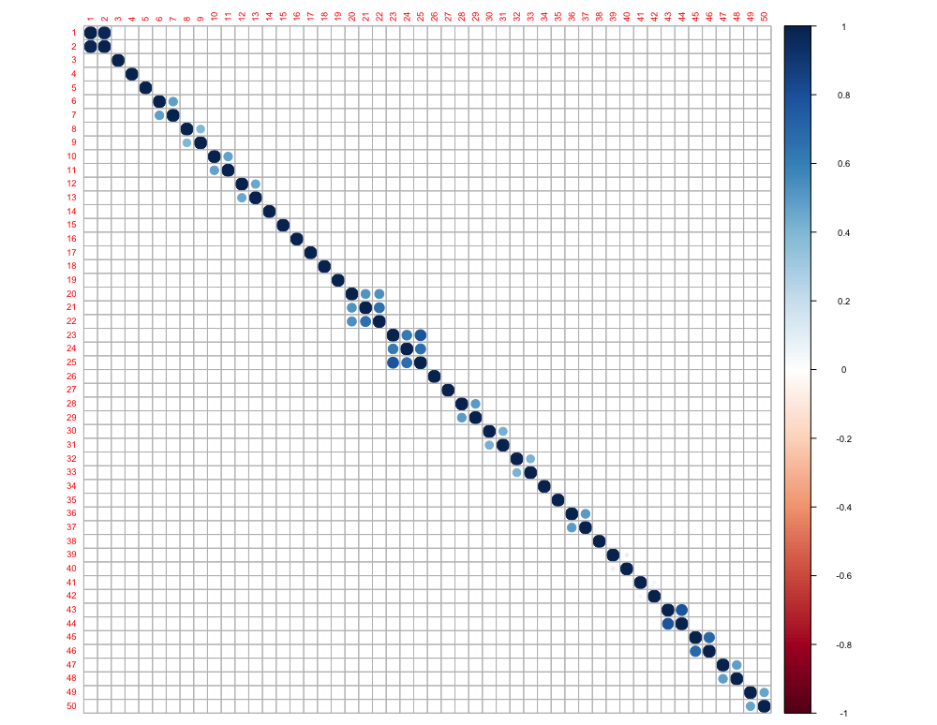
1. Meta-Analysis
Shared-Control Non-independence
## Calculate the M matrix M <- make_VCV_matrix(data = mass_data, V = "vi", cluster = "comparison_ID",
m = "control_mean", sd = "control_error", n = "control_N",
type = "vcv", vcal = "ROM",
obs = "obs")
## Plot the M matrix as a correlation matrix corrplot::corrplot(cov2cor(M))

Slide 41
Quantifying Heterogeneity
2. Heterogeneity Analysis
After controlling for non-independence and estimating meta-analytic means we want to calculate how much variation in effects exists
Why?
Tells us how consistent effects are across studies
Tells us how much variation is the result of sampling error relative to other drivers
Should ALWAYS accompany effect size means

Slide 42
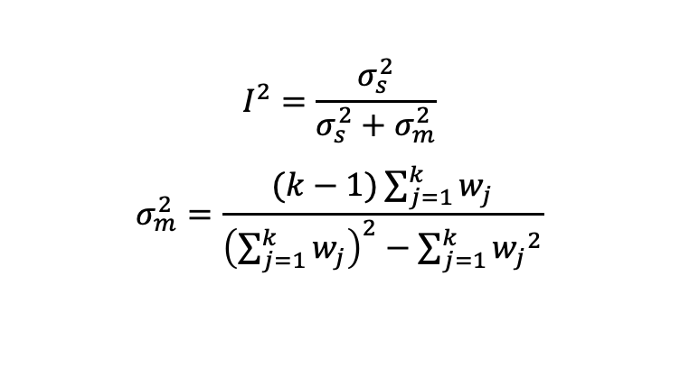
Quantifying Heterogeneity
2. Heterogeneity Analysis
Two common heterogeneity statistics
Cochran’s Q and I²
I² is a preferred measure of heterogeneity (it does not depend on the sample size while Q does)
Q-test only tell us whether there is any heterogeneity but not how much
I² is like effect size statistics
I² = 25, 50 & 75% (low, moderate & high)
$$I^{2}=\frac{σ_{s}^{2}}{σ_{s}^{2}+σ_{m}^{2}}$$
$$σ_{m}^{2}=\frac{(k−1)\sum_{j=1}^{k}{w_{j}}}{{\left(\sum_{j=1}^{k}{w_{j}}\right)}^{2}−\sum_{j=1}^{k}{{w_{j}}^{2}}}$$
k = the number of study
= the number of effect size
w = fixed effect weights
Higgins et al. (2003, BMJ)

Slide 43
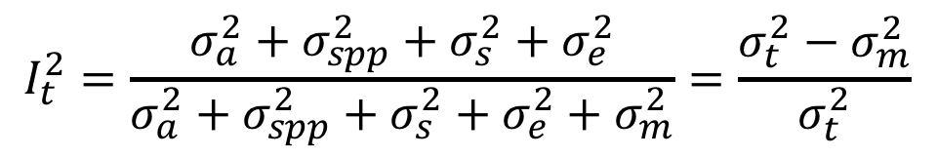
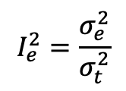
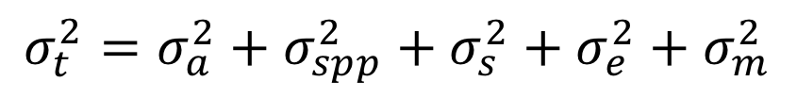
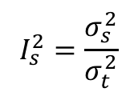
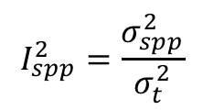
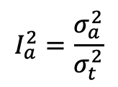
Heterogeneity: I² for multilevel models
2. Heterogeneity Analysis
Proportion of variation relative to total
I²_{t(total)} : Proportion of variance among effects after removing sampling variation
t = total
a = phylogenetic
spp = non-phylogenetic spp
s = study
e = effect size
m = sampling error
$$σ_{t}^{2}=σ_{a}^{2}+σ_{spp}^{2}+σ_{s}^{2}+σ_{e}^{2}+σ_{m}^{2}$$
$$I_{t}^{2}=\frac{σ_{a}^{2}+σ_{spp}^{2}+σ_{s}^{2}+σ_{e}^{2}}{σ_{a}^{2}+σ_{spp}^{2}+σ_{s}^{2}+σ_{e}^{2}+σ_{m}^{2}}=\frac{σ_{t}^{2}−σ_{m}^{2}}{σ_{t}^{2}}$$
$$I_{a}^{2}=\frac{σ_{a}^{2}}{σ_{t}^{2}}$$
$$I_{spp}^{2}=\frac{σ_{spp}^{2}}{σ_{t}^{2}}$$
$$I_{s}^{2}=\frac{σ_{s}^{2}}{σ_{t}^{2}}$$
$$I_{e}^{2}=\frac{σ_{e}^{2}}{σ_{t}^{2}}$$
Nakagawa & Santos (2012)

Slide 44
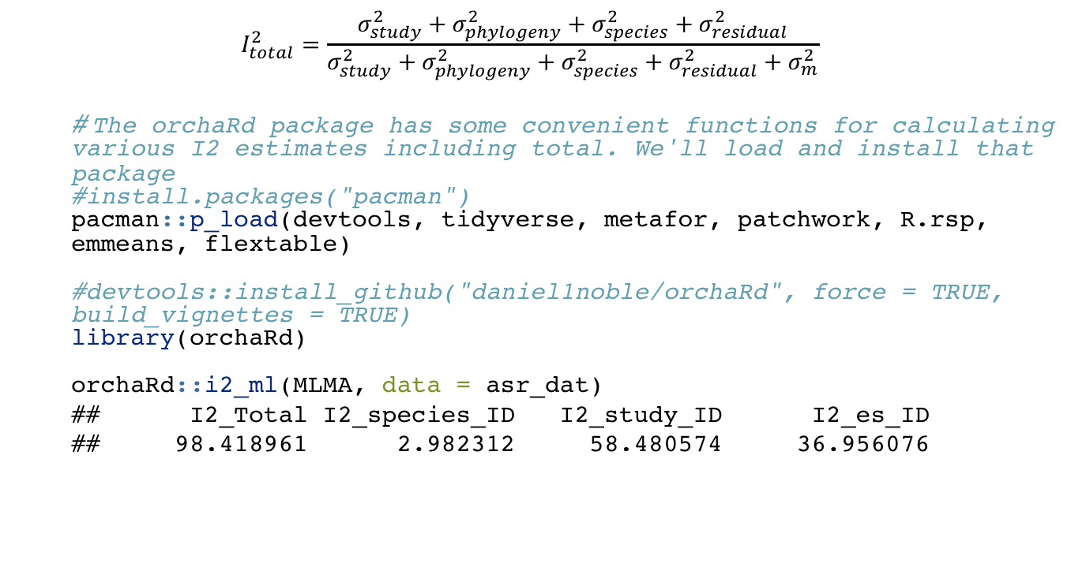
2. Heterogeneity Analysis
Heterogeneity: I² for multilevel models
$$I_{total}^{2}=\frac{σ_{study}^{2}+σ_{phylogeny}^{2}+σ_{species}^{2}+σ_{residual}^{2}}{σ_{study}^{2}+σ_{phylogeny}^{2}+σ_{species}^{2}+σ_{residual}^{2}+σ_{m}^{2}}$$
# The orchaRd package has some convenient functions for calculating various I2 estimates including total. We'll load and install that package #install.packages("pacman") pacman::p_load(devtools, tidyverse, metafor, patchwork, R.rsp, emmeans, flextable) #devtools::install_github("daniel1noble/orchaRd", force = TRUE, build_vignettes = TRUE) library(orchaRd) orchaRd::i2_ml(MLMA, data = asr_dat)
## I2_Total I2_species_ID I2_study_ID I2_es_ID ## 98.418961 2.982312 58.480574 36.956076

Slide 45
Heterogeneity: Prediction Intervals
2. Heterogeneity Analysis
I² and Q-tests, while useful, don’t always provide intuitive ways to interpret heterogeneity
Prediction intervals really capture effect heterogeneity
Recommend reporting these as they are very easy to understand and really tell you a lot about how much effects vary

Slide 46
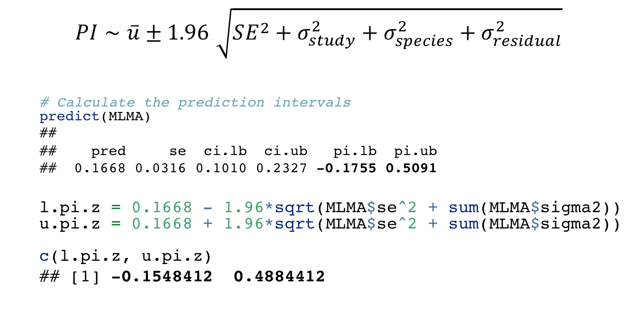
Heterogeneity: Prediction Intervals
2. Heterogeneity Analysis
$$PI∼\overset{‾}{u}±1.96\sqrt{SE^{2}+σ_{study}^{2}+σ_{species}^{2}+σ_{residual}^{2}}$$
# Calculate the prediction intervals predict(MLMA)
## ## pred se ci.lb ci.ub pi.lb pi.ub ## 0.1668 0.0316 0.1010 0.2327 -0.1755 0.5091
l.pi.z = 0.1668 - 1.96*sqrt(MLMA$se^2 + sum(MLMA$sigma2)) u.pi.z = 0.1668 + 1.96*sqrt(MLMA$se^2 + sum(MLMA$sigma2)) c(l.pi.z, u.pi.z)
## [1] -0.1548412 0.4884412

Slide 47
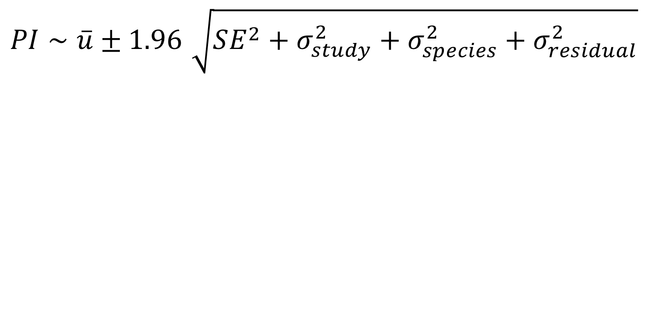
Heterogeneity: Prediction Intervals
2. Heterogeneity Analysis
$$PI∼\overset{‾}{u}±1.96\sqrt{SE^{2}+σ_{study}^{2}+σ_{species}^{2}+σ_{residual}^{2}}$$
Note: I say ~ (approximately) because we could use a t-statistics (with certain df) and this value gets adjusted for the calculation….

Slide 48
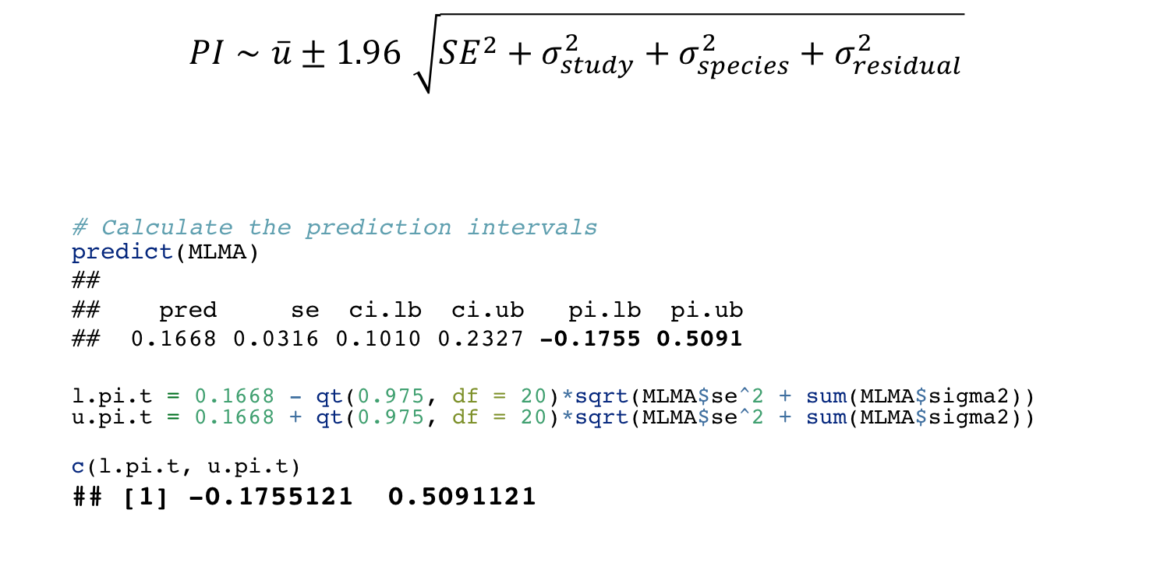
Heterogeneity: Prediction Intervals
2. Heterogeneity Analysis
$$PI∼\overset{‾}{u}±1.96\sqrt{SE^{2}+σ_{study}^{2}+σ_{species}^{2}+σ_{residual}^{2}}$$
# Calculate the prediction intervals predict(MLMA)
## ## pred se ci.lb ci.ub pi.lb pi.ub ## 0.1668 0.0316 0.1010 0.2327 -0.1755 0.5091
l.pi.t = 0.1668 - qt(0.975, df = 20)*sqrt(MLMA$se^2 + sum(MLMA$sigma2)) u.pi.t = 0.1668 + qt(0.975, df = 20)*sqrt(MLMA$se^2 + sum(MLMA$sigma2))
c(l.pi.t, u.pi.t)
## [1] -0.1755121 0.5091121
Calculate the test statistic based on the t-distribution instead of standard normal

Slide 49
Heterogeneity: Prediction Intervals
2. Heterogeneity Analysis
$$PI∼\overset{‾}{u}±1.96\sqrt{SE^{2}+σ_{study}^{2}+σ_{species}^{2}+σ_{residual}^{2}}$$
# Calculate the prediction intervals predict(MLMA)
## ## pred se ci.lb ci.ub pi.lb pi.ub ## 0.1668 0.0316 0.1010 0.2327 -0.1755 0.5091
l.pi.t = 0.1668 - qt(0.975, df = 20)*sqrt(MLMA$se^2 + sum(MLMA$sigma2)) u.pi.t = 0.1668 + qt(0.975, df = 20)*sqrt(MLMA$se^2 + sum(MLMA$sigma2))
c(l.pi.t, u.pi.t)
## [1] -0.1755121 0.5091121
Calculate the test statistic based on the t-distribution instead of standard normal
What do the prediction intervals tell us about our overall meta-analytic mean?

Slide 50
How might we write up our results?
1. Meta-analysis 2. Heterogeneity Analysis
# Multi-level meta-analytic model MLMA <- metafor::rma.mv(yi= ARR~ 1, V = V_ARR, method="REML", random=list(~1|species_ID, ~1|authors, ~1|es_ID), dfs = "contain", test="t", data=asr_dat) ## Multivariate Meta-Analysis Model (k = 123; method: REML) ## ## Variance Components: ## ## estim sqrt nlvls fixed factor ## sigma^2.1 0.0008 0.0280 29 no species_ID ## sigma^2.2 0.0154 0.1241 21 no authors ## sigma^2.3 0.0097 0.0987 123 no es_ID ## ## Test for Heterogeneity: ## Q(df = 122) = 3941.0055, p-val < .0001 ## ## Model Results: ## ## estimate se tval df pval ci.lb ci.ub ​ ## 0.1668 0.0316 5.2857 20 <.0001 0.1010 0.2327 *** ## ## --- ## Signif. codes: 0 '***' 0.001 '**' 0.01 '*' 0.05 '.' 0.1 ' ' 1

Slide 51
1. Meta-analysis 2. Heterogeneity Analysis
# Multi-level meta-analytic model MLMA <- metafor::rma.mv(yi= ARR~ 1, V = V_ARR, method="REML", random=list(~1|species_ID, ~1|authors, ~1|es_ID), dfs = "contain", test="t", data=asr_dat) ## Multivariate Meta-Analysis Model (k = 123; method: REML) ## ## Variance Components: ## ## estim sqrt nlvls fixed factor ## sigma^2.1 0.0008 0.0280 29 no species_ID ## sigma^2.2 0.0154 0.1241 21 no authors ## sigma^2.3 0.0097 0.0987 123 no es_ID ## ## Test for Heterogeneity: ## Q(df = 122) = 3941.0055, p-val < .0001 ## ## Model Results: ## ## estimate se tval df pval ci.lb ci.ub ​ ## 0.1668 0.0316 5.2857 20 <.0001 0.1010 0.2327 *** ## ## --- ## Signif. codes: 0 '***' 0.001 '**' 0.01 '*' 0.05 '.' 0.1 ' ' 1
On average, across female ectotherms, for every 1℃ increase in acclimation temperature heat tolerance increases by 0.167℃
We are 95% confident that the true mean falls between 0.101℃ and 0.233℃
We do have a significant amount of heterogeneity among effects (Q = 3941, df = 122, p = <0.001), with effect sizes expected to be as low as -0.176℃ to as high as 0.509℃ 95% of the time. Differences among studies and species explain

Slide 52
1. Meta-analysis 2. Heterogeneity Analysis
# Multi-level meta-analytic model MLMA <- metafor::rma.mv(yi= ARR~ 1, V = V_ARR, method="REML", random=list(~1|species_ID, ~1|authors, ~1|es_ID), dfs = "contain", test="t", data=asr_dat) ## Multivariate Meta-Analysis Model (k = 123; method: REML) ## ## Variance Components: ## ## estim sqrt nlvls fixed factor ## sigma^2.1 0.0008 0.0280 29 no species_ID ## sigma^2.2 0.0154 0.1241 21 no authors ## sigma^2.3 0.0097 0.0987 123 no es_ID ## ## Test for Heterogeneity: ## Q(df = 122) = 3941.0055, p-val < .0001 ## ## Model Results: ## ## estimate se tval df pval ci.lb ci.ub ​ ## 0.1668 0.0316 5.2857 20 <.0001 0.1010 0.2327 *** ## ## --- ## Signif. codes: 0 '***' 0.001 '**' 0.01 '*' 0.05 '.' 0.1 ' ' 1
On average, across female ectotherms, for every 1℃ increase in acclimation temperature heat tolerance increases by 0.167℃
We are 95% confident that the true mean falls between 0.101℃ and 0.233℃
We do have a significant amount of heterogeneity among effects (Q = 3941, df = 122, p = <0.001), with effect sizes expected to be as low as -0.176℃ to as high as 0.509℃ 95% of the time. Differences among studies and species explain

Slide 53
1. Meta-analysis 2. Heterogeneity Analysis
# Multi-level meta-analytic model MLMA <- metafor::rma.mv(yi= ARR~ 1, V = V_ARR, method="REML", random=list(~1|species_ID, ~1|authors, ~1|es_ID), dfs = "contain", test="t", data=asr_dat) ## Multivariate Meta-Analysis Model (k = 123; method: REML) ## ## Variance Components: ## ## estim sqrt nlvls fixed factor ## sigma^2.1 0.0008 0.0280 29 no species_ID ## sigma^2.2 0.0154 0.1241 21 no authors ## sigma^2.3 0.0097 0.0987 123 no es_ID ## ## Test for Heterogeneity: ## Q(df = 122) = 3941.0055, p-val < .0001 ## ## Model Results: ## ## estimate se tval df pval ci.lb ci.ub ​ ## 0.1668 0.0316 5.2857 20 <.0001 0.1010 0.2327 *** ## ## --- ## Signif. codes: 0 '***' 0.001 '**' 0.01 '*' 0.05 '.' 0.1 ' ' 1
On average, across female ectotherms, for every 1℃ increase in acclimation temperature heat tolerance increases by 0.167℃
We are 95% confident that the true mean falls between 0.101℃ and 0.233℃
We do have a significant amount of heterogeneity among effects (Q = 3941, df = 122, p = <0.001), with effect sizes expected to be as low as -0.176℃ to as high as 0.509℃ 95% of the time. Differences among studies and species explain 58% and 3% of effect size variation, respectively.

Slide 54
We found variation (a lot)! Now what? Multilevel Meta-regression
3. Meta-regression and Publication bias
Heterogeneity in meta-analyses is HIGH! (Senior et al. 2016)
Now we have identified so much of it the next major goal is to explain what drives effect variability?
Methodological
Experimental, observational, dosages, temperatures?
Biological
Body size of species, latitude, foraging mode, thermoregulatory strategies
Publication biases…..we’ll get to this later.

Slide 55
What factors might we expect to drive variation in ARR?
3. Meta-regression and Publication bias
Based on our muti-level meta-analytic model what types of moderators would you focus on and why?
We might hypothesise:
Biological: Different major taxonomic groups are likely to respond to acclimation temperature in different ways and/or be better at acclimating
We predict that ARR's should differ significant across different classes of organisms
Methodological: Does the way in which thermal tolerance is measured changed the expected meta-analytic mean?
We predict that ARR’s should differ if thermal tolerance is quantified through CT_{max} compared to Lethal Thermal Limits (LT_{max})
## Multivariate Meta-Analysis Model (k = 123; method: REML) ## ## Variance Components: ## ## estim sqrt nlvls fixed factor ## sigma^2.1 0.0008 0.0280 29 no species_ID ## sigma^2.2 0.0154 0.1241 21 no authors ## sigma^2.3 0.0097 0.0987 123 no es_ID ## ## Test for Heterogeneity: ## Q(df = 122) = 3941.0055, p-val < .0001 ## ## Model Results: ## ## estimate se tval df pval ci.lb ci.ub ​ ## 0.1668 0.0316 5.2857 20 <.0001 0.1010 0.2327 *** ## ## --- ## Signif. codes: 0 '***' 0.001 '**' 0.01 '*' 0.05 '.' 0.1 ' ' 1

Slide 56
What factors might we expect to drive variation in ARR?
3. Meta-regression and Publication bias
Based on our muti-level meta-analytic model what types of moderators would you focus on and why?
We might hypothesize:
Biological: Different major taxonomic groups are likely to respond to acclimation temperature in different ways and/or be better at acclimating
We predict that ARR's should differ significant across different classes of organisms
Methodological: Does the way in which thermal tolerance is measured changed the expected meta-analytic mean?
We predict that ARR’s should differ if thermal tolerance is quantified through CT_{max} compared to Lethal Thermal Limits (LT_{max})

Slide 57
What factors might we expect to drive variation in ARR?
3. Meta-regression and Publication bias
Based on our muti-level meta-analytic model what types of moderators would you focus on and why?
We might hypothesize:
Biological: Different major taxonomic groups are likely to respond to acclimation temperature in different ways and/or be better at acclimating
We predict that ARR's should differ significant across different classes of organisms
Methodological: Does the way in which thermal tolerance is measured changed the expected meta-analytic mean?
We predict that ARR’s should differ if thermal tolerance is quantified through CT_{max} compared to Lethal Thermal Limits (LT_{max})

Slide 58
What factors might we expect to drive variation in ARR?
3. Meta-regression and Publication bias
Based on our muti-level meta-analytic model what types of moderators would you focus on and why?
We might hypothesize:
Biological: Different major taxonomic groups are likely to respond to acclimation temperature in different ways and/or be better at acclimating
We predict that ARR's should differ significant across different classes of organisms
Methodological: Does the way in which thermal tolerance is measured changed the expected meta-analytic mean?
We predict that ARR’s should differ if thermal tolerance is quantified through CT_{max} compared to Lethal Thermal Limits (LT_{max})

Slide 59
What factors might we expect to drive variation in ARR?
3. Meta-regression and Publication bias
Based on our muti-level meta-analytic model what types of moderators would you focus on and why?
We might hypothesize:
Biological: Different major taxonomic groups are likely to respond to acclimation temperature in different ways and/or be better at acclimating
We predict that ARR's should differ significant across different classes of organisms
Methodological: Does the way in which thermal tolerance is measured changed the expected meta-analytic mean?
We predict that ARR’s should differ if thermal tolerance is quantified through CT_{max} compared to Lethal Thermal Limits (LT_{max})

Slide 60
Multilevel Meta-regression Model
3. Meta-regression and Publication bias
meta_reg <- metafor::rma.mv(yi= ARR ~ 1 + method + class, V = V_ARR, method="REML", random=list(~1|species_ID, ~1|study_ID, ~1|es_ID), dfs = "contain", test="t", data=asr_dat) ## ## Multivariate Meta-Analysis Model (k = 123; method: REML) ## ## Variance Components: ## ## estim sqrt nlvls fixed factor ## sigma^2.1 0.0009 0.0305 29 no species_ID ## sigma^2.2 0.0037 0.0605 21 no study_ID ## sigma^2.3 0.0105 0.1024 123 no es_ID ## ## Test for Residual Heterogeneity: ## QE(df = 115) = 898.2185, p-val < .0001 ## ## Test of Moderators (coefficients 2:8): ## F(df1 = 7, df2 = 13) = 4.0631, p-val = 0.0142 ## ## Model Results: ## ## estimate se tval df pval ci.lb ci.ub​ ## intrcpt 0.2953 0.0381 7.7505 13 <.0001 0.2130 0.3776 *** ## methodLTmax -0.0541 0.0569 -0.9507 115 0.3438 -0.1667 0.0586 ## classAmphibia -0.0312 0.1029 -0.3035 13 0.7663 -0.2534 0.1910 ## classArachnida -0.3432 0.1347 -2.5477 13 0.0243 -0.6341 -0.0522 * ## classChondrichthyes 0.0453 0.1113 0.4072 13 0.6905 -0.1951 0.2857 ## classInsecta -0.2331 0.0517 -4.5114 13 0.0006 -0.3447 -0.1215 *** ## classMalacostraca -0.1331 0.0598 -2.2271 13 0.0442 -0.2623 -0.0040 * ## classReptilia -0.2291 0.1071 -2.1393 13 0.0520 -0.4605 0.0023 . ## --- ## Signif. codes: 0 '***' 0.001 '**' 0.01 '*' 0.05 '.' 0.1 ' ' 1

Slide 61
Multilevel Meta-regression Model
3. Meta-regression and Publication bias
meta_reg <- metafor::rma.mv(yi= ARR ~ 1 + method + class, V = V_ARR, method="REML", random=list(~1|species_ID, ~1|study_ID, ~1|es_ID), dfs = "contain", test="t", data=asr_dat) ## ## Multivariate Meta-Analysis Model (k = 123; method: REML) ## ## Variance Components: ## ## estim sqrt nlvls fixed factor ## sigma^2.1 0.0009 0.0305 29 no species_ID ## sigma^2.2 0.0037 0.0605 21 no study_ID ## sigma^2.3 0.0105 0.1024 123 no es_ID ## ## Test for Residual Heterogeneity: ## QE(df = 115) = 898.2185, p-val < .0001 ## ## Test of Moderators (coefficients 2:8): ## F(df1 = 7, df2 = 13) = 4.0631, p-val = 0.0142 ## ## Model Results: ## ## estimate se tval df pval ci.lb ci.ub​ ## intrcpt 0.2953 0.0381 7.7505 13 <.0001 0.2130 0.3776 *** ## methodLTmax -0.0541 0.0569 -0.9507 115 0.3438 -0.1667 0.0586 ## classAmphibia -0.0312 0.1029 -0.3035 13 0.7663 -0.2534 0.1910 ## classArachnida -0.3432 0.1347 -2.5477 13 0.0243 -0.6341 -0.0522 * ## classChondrichthyes 0.0453 0.1113 0.4072 13 0.6905 -0.1951 0.2857 ## classInsecta -0.2331 0.0517 -4.5114 13 0.0006 -0.3447 -0.1215 *** ## classMalacostraca -0.1331 0.0598 -2.2271 13 0.0442 -0.2623 -0.0040 * ## classReptilia -0.2291 0.1071 -2.1393 13 0.0520 -0.4605 0.0023 . ## --- ## Signif. codes: 0 '***' 0.001 '**' 0.01 '*' 0.05 '.' 0.1 ' ' 1
F-test indicates moderators explain significant variation in female ARR

Slide 62
Multilevel Meta-regression Model
3. Meta-regression and Publication bias
meta_reg <- metafor::rma.mv(yi= ARR ~ 1 + method + class, V = V_ARR, method="REML", random=list(~1|species_ID, ~1|study_ID, ~1|es_ID), dfs = "contain", test="t", data=asr_dat) ## ## Multivariate Meta-Analysis Model (k = 123; method: REML) ## ## Variance Components: ## ## estim sqrt nlvls fixed factor ## sigma^2.1 0.0009 0.0305 29 no species_ID ## sigma^2.2 0.0037 0.0605 21 no study_ID ## sigma^2.3 0.0105 0.1024 123 no es_ID ## ## Test for Residual Heterogeneity: ## QE(df = 115) = 898.2185, p-val < .0001 ## ## Test of Moderators (coefficients 2:8): ## F(df1 = 7, df2 = 13) = 4.0631, p-val = 0.0142 ## ## Model Results: ## ## estimate se tval df pval ci.lb ci.ub​ ## intrcpt 0.2953 0.0381 7.7505 13 <.0001 0.2130 0.3776 *** ## methodLTmax -0.0541 0.0569 -0.9507 115 0.3438 -0.1667 0.0586 ## classAmphibia -0.0312 0.1029 -0.3035 13 0.7663 -0.2534 0.1910 ## classArachnida -0.3432 0.1347 -2.5477 13 0.0243 -0.6341 -0.0522 * ## classChondrichthyes 0.0453 0.1113 0.4072 13 0.6905 -0.1951 0.2857 ## classInsecta -0.2331 0.0517 -4.5114 13 0.0006 -0.3447 -0.1215 *** ## classMalacostraca -0.1331 0.0598 -2.2271 13 0.0442 -0.2623 -0.0040 * ## classReptilia -0.2291 0.1071 -2.1393 13 0.0520 -0.4605 0.0023 . ## --- ## Signif. codes: 0 '***' 0.001 '**' 0.01 '*' 0.05 '.' 0.1 ' ' 1
Studies quantifying female thermal tolerance using LT_{max} decreases ARR, on average, by 0.054℃ compared to those measuring thermal tolerance with CT_{max}, but this is not significantly different from 0

Slide 63
Multilevel Meta-regression Model
3. Meta-regression and Publication bias
meta_reg <- metafor::rma.mv(yi= ARR ~ 1 + method + class, V = V_ARR, method="REML", random=list(~1|species_ID, ~1|study_ID, ~1|es_ID), dfs = "contain", test="t", data=asr_dat) ## ## Multivariate Meta-Analysis Model (k = 123; method: REML) ## ## Variance Components: ## ## estim sqrt nlvls fixed factor ## sigma^2.1 0.0009 0.0305 29 no species_ID ## sigma^2.2 0.0037 0.0605 21 no study_ID ## sigma^2.3 0.0105 0.1024 123 no es_ID ## ## Test for Residual Heterogeneity: ## QE(df = 115) = 898.2185, p-val < .0001 ## ## Test of Moderators (coefficients 2:8): ## F(df1 = 7, df2 = 13) = 4.0631, p-val = 0.0142 ## ## Model Results: ## ## estimate se tval df pval ci.lb ci.ub​ ## intrcpt 0.2953 0.0381 7.7505 13 <.0001 0.2130 0.3776 *** ## methodLTmax -0.0541 0.0569 -0.9507 115 0.3438 -0.1667 0.0586 ## classAmphibia -0.0312 0.1029 -0.3035 13 0.7663 -0.2534 0.1910 ## classArachnida -0.3432 0.1347 -2.5477 13 0.0243 -0.6341 -0.0522 * ## classChondrichthyes 0.0453 0.1113 0.4072 13 0.6905 -0.1951 0.2857 ## classInsecta -0.2331 0.0517 -4.5114 13 0.0006 -0.3447 -0.1215 *** ## classMalacostraca -0.1331 0.0598 -2.2271 13 0.0442 -0.2623 -0.0040 * ## classReptilia -0.2291 0.1071 -2.1393 13 0.0520 -0.4605 0.0023 . ## --- ## Signif. codes: 0 '***' 0.001 '**' 0.01 '*' 0.05 '.' 0.1 ' ' 1
Compared to CT_{max} studies on Actinopterygii we see that there are significantly smaller mean female ARR in Arachnida, Malacostraca and Insecta. Reptiles also have a smaller ARR compared to Actinopterygii by this is not significant at alpha = 0.05.

Slide 64
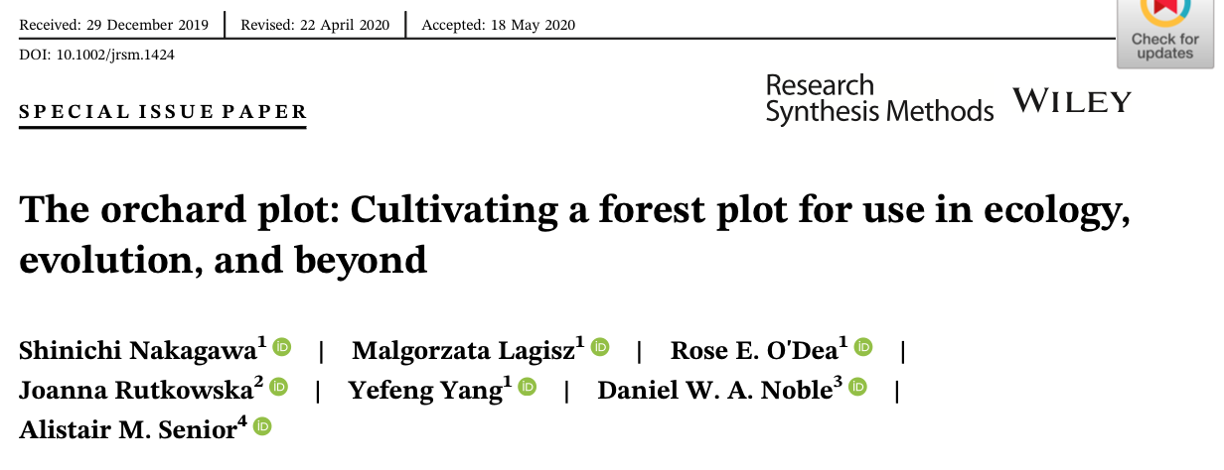
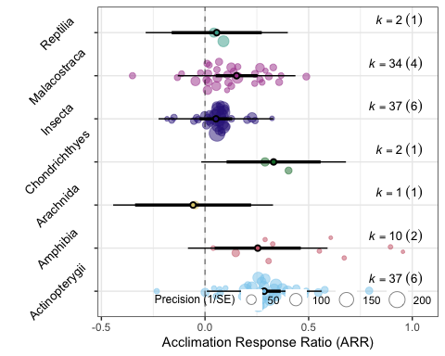
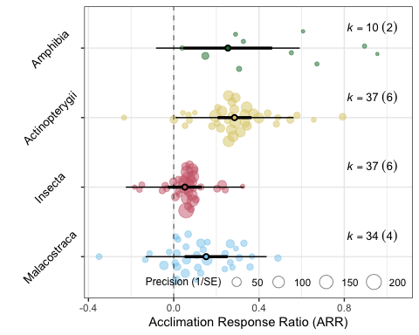
Orchard plots Note: We’re working on orchard version 2.0! https://github.com/daniel1noble/orchaRd
3. Meta-regression and Publication bias
mod_table <- orchaRd::mod_results(meta_reg, data = asr_dat, mod = "class", group = "study_ID", at = list(class = c("Malacostraca", "Insecta", "Actinopterygii", "Amphibia")), subset = TRUE) orchaRd::orchard_plot(mod_table, xlab = "Acclimation Response Ratio (ARR)", angle = 45)
orchaRd::orchard_plot(meta_reg, data = asr_dat, mod = "class", group = "study_ID", xlab = "Acclimation Response Ratio (ARR)", angle = 45)

Slide 65
Orchard plots Note: We’re working on orchard version 2.0! https://github.com/daniel1noble/orchaRd
3. Meta-regression and Publication bias
mod_table <- orchaRd::mod_results(meta_reg, data = asr_dat, mod = "class", group = "study_ID", at = list(class = c("Malacostraca", "Insecta", "Actinopterygii", "Amphibia")), subset = TRUE) orchaRd::orchard_plot(mod_table, xlab = "Acclimation Response Ratio (ARR)", angle = 45)
orchaRd::orchard_plot(meta_reg, data = asr_dat, mod = "class", group = "study_ID", xlab = "Acclimation Response Ratio (ARR)", angle = 45)

Slide 66
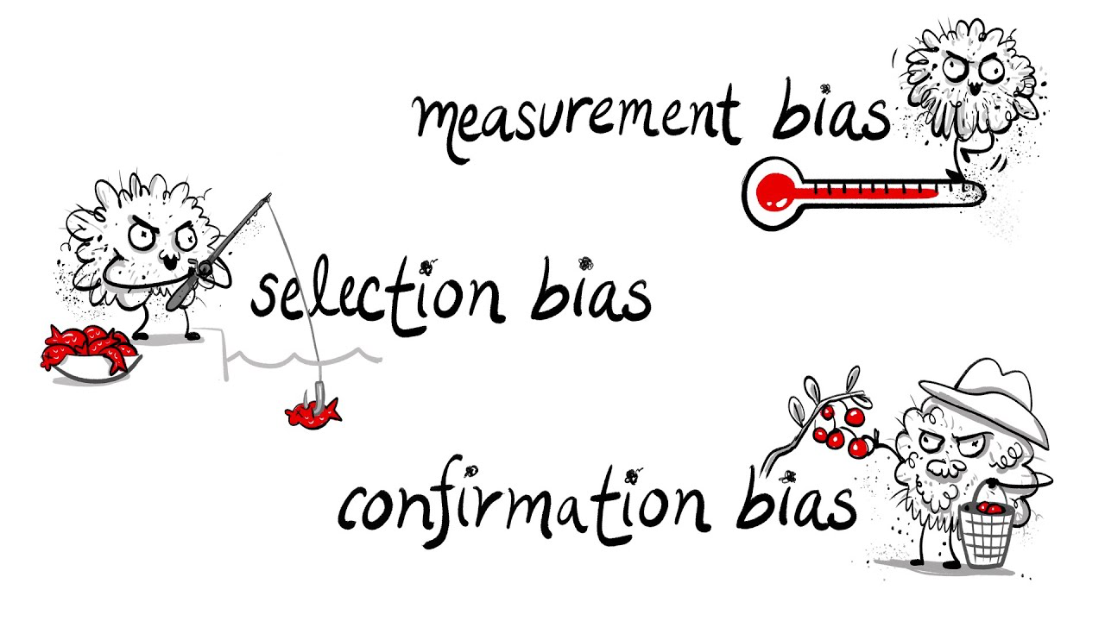

Publication bias
3. Meta-regression and Publication bias
Effect size heterogeneity can also be driven by biases in publishing practices in the literature
Publication bias: “bias owing to the influence of research findings on submission, reviews and editorial decisions” (Møller & Jennions 2001)
Bias can result from:
Non-significant results going unpublished (‘file-drawer’ problem)
‘p-hacking’
Time-lag bias
Notes:
https://www.youtube.com/watch?v=BNICMrYtPJY
https://www.sciencedirect.com/science/article/abs/pii/S0169534701022352

Slide 67





Publication bias
3. Meta-regression and Publication bias
Massively important topic because meta-analysis relies on the sample of studies being random
Huge number of tools, both visual and analytical, have been developed to try and identify and correct bias
Notes:
https://www.youtube.com/watch?v=BNICMrYtPJY
https://www.sciencedirect.com/science/article/abs/pii/S0169534701022352

Slide 68



3. Meta-regression and Publication bias
Publication bias
Two major goals:
Identifying publication bias
Correcting for publication bias
Various graphical and analytical approaches:
Funnel Plots
Trim and Fill
Radial plots
Meta-regression
Egger’s regression
Selection models

Slide 69
3. Meta-regression and Publication bias
Publication bias
Two major goals:
Identifying publication bias
Correcting for publication bias
Various graphical and analytical approaches:
Funnel Plots
Trim and Fill
Radial plots
Meta-regression
Egger’s regression
Selection models

Slide 70


3. Meta-regression and Publication bias
Funnel plots
metafor::funnel(x = arnold_data_endo$Zr, vi = arnold_data_endo$Zr_v, yaxis = "seinv", digits = 2, level = c(0.1, 0.05, 0.01), shade = c("white", "gray55", "gray 75"), las = 1, xlab = "Correlation Coefficient (r)", atransf = tanh, legend = TRUE)

Slide 71
3. Meta-regression and Publication bias
Funnel plots
What would we expect publication bias to look like and why?

Slide 72
3. Meta-regression and Publication bias
Funnel plots
Funnel plot with raw data can be problematic as asymmetry can result from
Heterogeneity
Chance fluctuations
Non-independence
Data irregularities

Slide 73

3. Meta-regression and Publication bias
Funnel plots

Slide 74

3. Meta-regression and Publication bias
Multi-level Meta-regression
Publication bias
SE or V as moderator in analysis (depending on whether intercept is significant) (Nakagawa et al. 2022)
Explicit inferential test for publication bias
Can correct meta-analytic mean (intercept) for when ‘no sampling error exists’
$$y_{i}=μ+β_{se}se+s_{j\left[i\right]}+spp_{k\left[i\right]}+e_{i}+m_{i}$$
Time-lag bias
Initial results are inflated, usually lower powered, and over time effects converge on ‘true’ effect
Cumulative meta-analysis
$$y_{i}=μ+\sum_{i=1}^{N_{m}}{β_{m}}x_{m}+β_{se}se+β_{y}Year+s_{j\left[i\right]}+spp_{k\left[i\right]}+e_{i}+m_{i}$$

Slide 75
3. Meta-regression and Publication bias
Multi-level Meta-regression
Publication bias
SE or V as moderator in analysis (depending on whether intercept is significant) (Nakagawa et al. 2022)
Explicit inferential test for publication bias
Can correct meta-analytic mean (intercept) for when ‘no sampling error exists’
$$y_{i}=μ+β_{se}se+s_{j\left[i\right]}+spp_{k\left[i\right]}+e_{i}+m_{i}$$
Time-lag bias
Initial results are inflated, usually lower powered, and over time effects converge on ‘true’ effect
Cumulative meta-analysis
$$y_{i}=μ+\sum_{i=1}^{N_{m}}{β_{m}}x_{m}+β_{se}se+β_{y}Year+s_{j\left[i\right]}+spp_{k\left[i\right]}+e_{i}+m_{i}$$

Slide 76
3. Meta-regression and Publication bias
Multi-level Meta-regression
# Including sampling standard error as moderator metareg_se <- rma.mv(yi = Zr, V = Zr_v, mods = ~ sqrt(Zr_v), test = "t", dfs = "contain", data = arnold_data_endo, random = list(~1|Ref, ~1|obs)) summary(metareg_se)
## ## Multivariate Meta-Analysis Model (k = 209; method: REML) ## ## logLik Deviance AIC BIC AICc ​ ## -77.9464 155.8928 163.8928 177.2237 164.0908 ## ## Variance Components: ## ## estim sqrt nlvls fixed factor ## sigma^2.1 0.0626 0.2503 62 no Ref ## sigma^2.2 0.0380 0.1951 209 no obs ## … ## Model Results: ## ## estimate se tval df pval ci.lb ci.ub ​ ## intrcpt -0.0668 0.0727 -0.9184 60 0.3621 -0.2122 0.0787 ## sqrt(Zr_v) 1.3908 0.3674 3.7857 207 0.0002 0.6665 2.1151 *** ## ## --- ## Signif. codes: 0 '***' 0.001 '**' 0.01 '*' 0.05 '.' 0.1 ' ' 1

Slide 77
3. Meta-regression and Publication bias
Multi-level Meta-regression
# Including sampling standard error as moderator and year arnold_data_endo$se <- sqrt(arnold_data_endo$Zr_v) arnold_data_endo$c_log_year <- scale(log(arnold_data_endo$Year)) # Fit model metareg_se_time <- rma.mv(yi = Zr, V = Zr_v, mods = ~ se + c_log_year, test = "t", dfs = "contain", data = arnold_data_endo, random = list(~1|Ref, ~1|obs)) summary(metareg_se_time)
## ## Multivariate Meta-Analysis Model (k = 209; method: REML) ## ## logLik Deviance AIC BIC AICc ​ ## -74.9818 149.9636 159.9636 176.6030 160.2636 ## ## Variance Components ## estim sqrt nlvls fixed factor ## sigma^2.1 0.0569 0.2385 62 no Ref ## sigma^2.2 0.0376 0.1940 209 no obs ## … ## Model Results: ## ## estimate se tval df pval ci.lb ci.ub ​ ## intrcpt -0.0202 0.0733 -0.2757 59 0.7837 -0.1669 0.1265 ## se 1.1444 0.3734 3.0644 206 0.0025 0.4081 1.8806 ** ## c_log_year -0.0949 0.0408 -2.3251 59 0.0235 -0.1765 -0.0132 * ## Signif. codes: 0 '***' 0.001 '**' 0.01 '*' 0.05 '.' 0.1 ' ' 1

Slide 78

3. Meta-regression and Publication bias
Multi-level Meta-regression
# Bubble plots! p1 <- orchaRd::bubble_plot(metareg_se_time, mod = "se", group = "Ref", data = arnold_data_endo, xlab = "Sampling Standard Error (SE)", ylab = "Zr”, legend.pos = ”bottom.left") p2 <- orchaRd::bubble_plot(metareg_se_time, mod = "c_log_year", group = "Ref", data = arnold_data_endo, xlab = "Publication Year (log-transformed & scaled)", ylab = "Zr”, legend.pos = ”none")

Slide 79

Thanks!
We hope you learnt a bunch and enjoyed the workshop!
Any feedback you can provide on what you liked or didn’t like please let us know.
https://forms.gle/h4TCAbNpJiVxsypk8
Let’s have a chat about all the cool meta-analyses you’re all doing!

